Slide 1
HOME AUTOMATION USING ARDUINO
PRODUCT DESIGN PRACTICE
INSTRUCTOR’S NAME
DR.K.KRISHNA NAIK
DR.G.PRAVEEN KUMAR

Slide 2


MEET OUR TEAM
‘DIGITAL ALPHA’
AMAN KUMAR
01
120ME0026
ROHIT BAJIYA
02
120ME0013
ABISHEK SHARMA
03
120ME0008
P.JOSHNA
04
120EC0007
M.PUSHPALATHA
05
120EC0033

Slide 3
PROBLEM STATEMENT
“Alternate way of controlling household appliances instead of manual control, for energy saving and time saving etc”

Slide 4
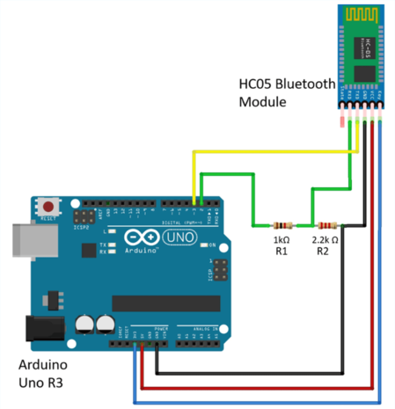
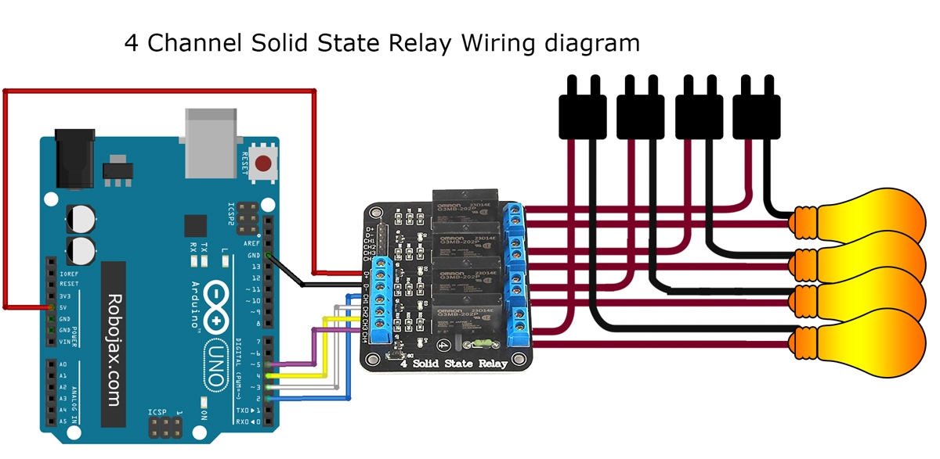
Quick Recap…..
Contents
Performance
Contents
Performance

Slide 5
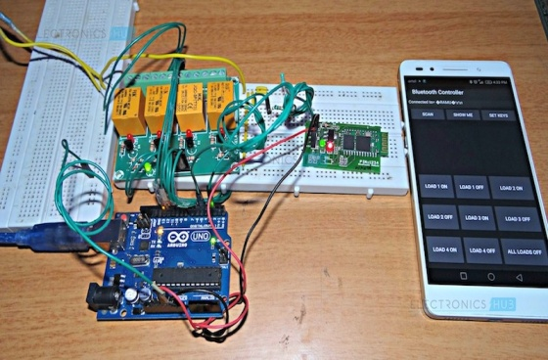
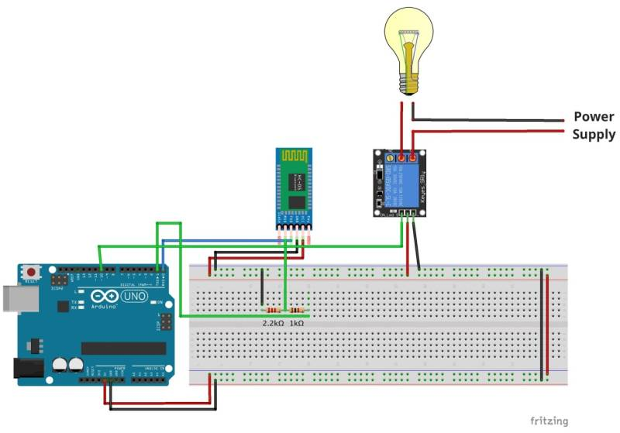
Circuit Model

Slide 6
How does that Work?
char val;
void setup() {
pinMode(13,OUTPUT);
Serial.begin(9600);
digitalWrite(13,HIGH);
}
void loop() {
if(Serial.available()){
val = Serial.read();
Serial.println(val);
}
if(val=='1'){
digitalWrite(13,LOW);
}
else if(val=='2'){
digitalWrite(13,HIGH);
}
delay(100);
}

Slide 7
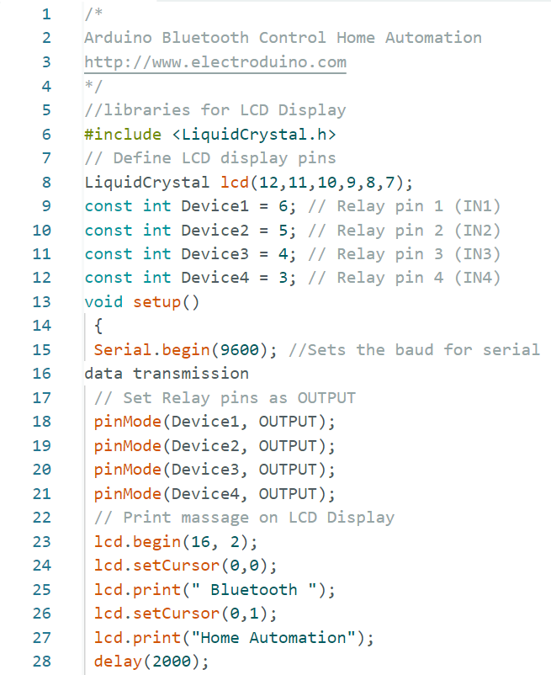
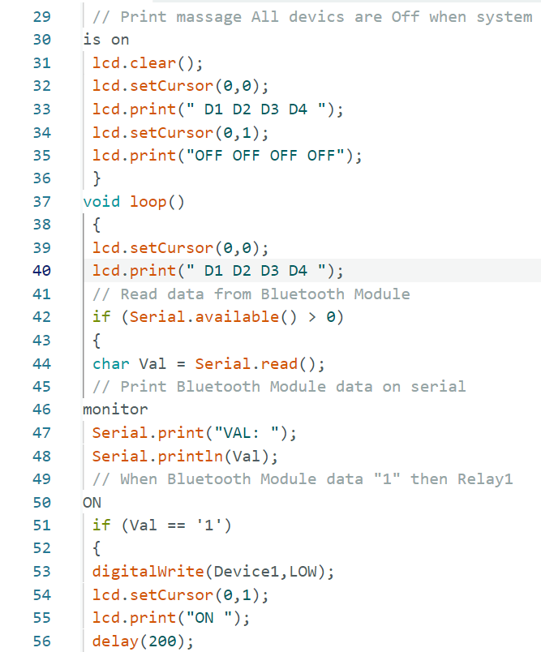
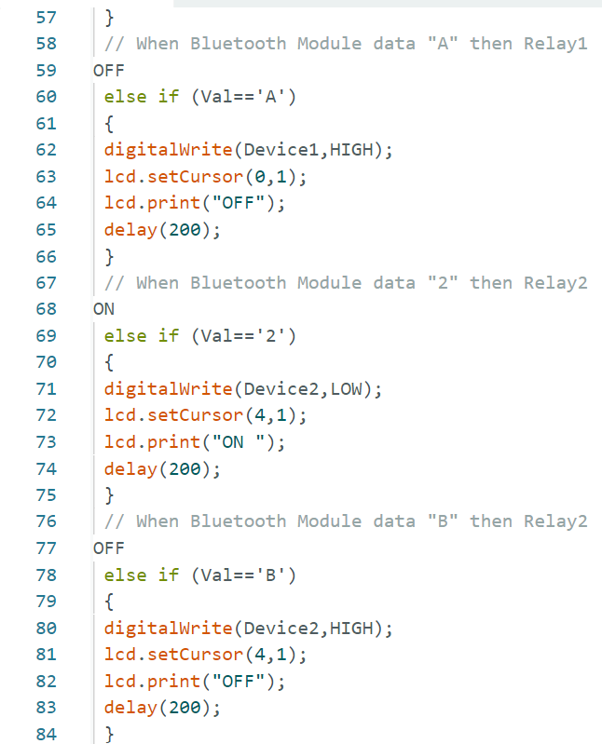
ARDUINO BLUETOOTH CODE

Slide 8
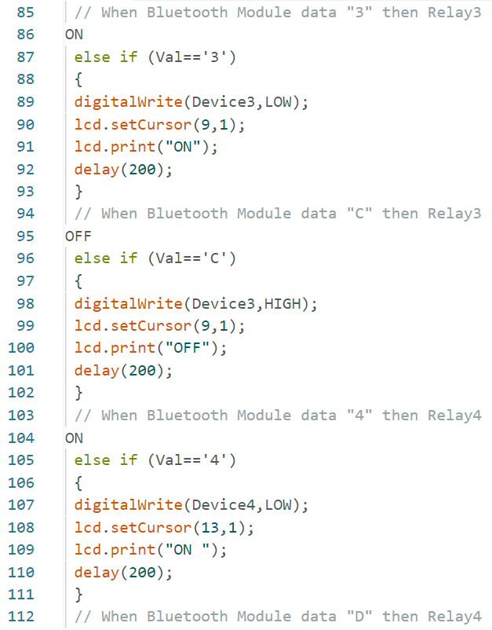
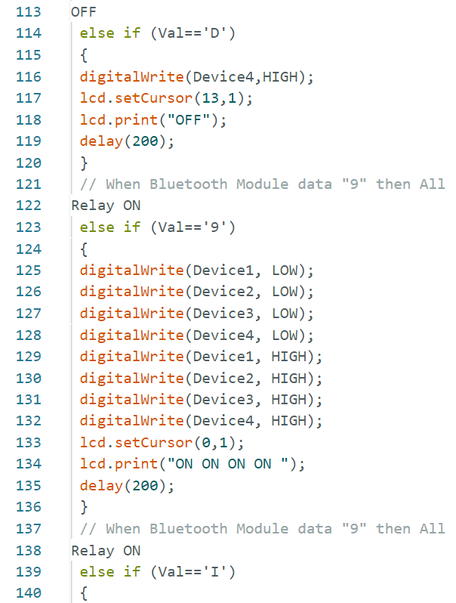
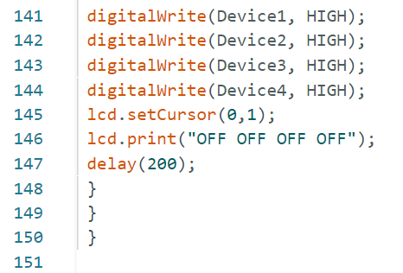
ARDUINO BLUETOOTH CODE

Slide 9
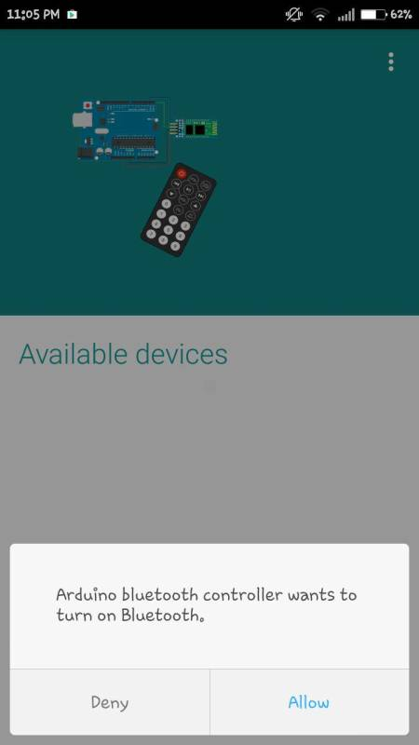
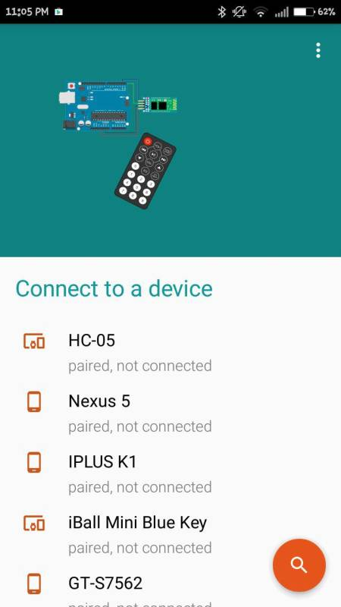
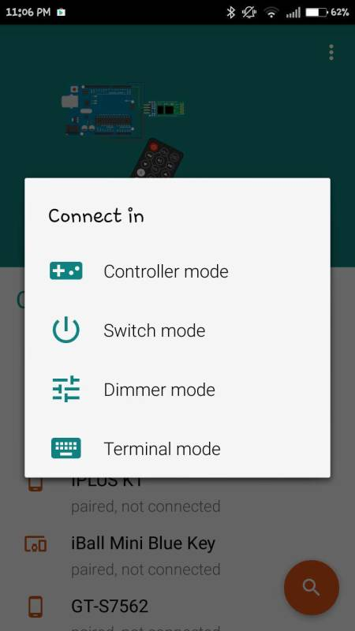
Arduino Bluetooth Controller APP
Open the app and allow Bluetooth connections.
Select Bluetooth HC-05.
Connect to switch mode.

Slide 10
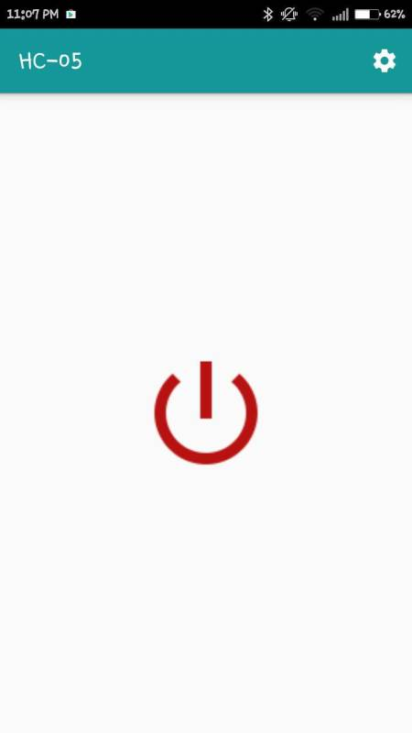
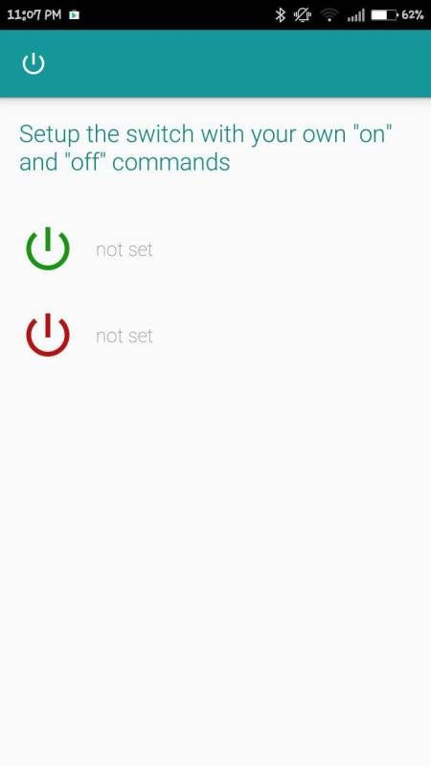
Arduino Bluetooth Controller App
Click on the settings button.
Enter ‘1’ in the ON textbox and ‘0’ in the OFF textbox. Click Submit.

Slide 11
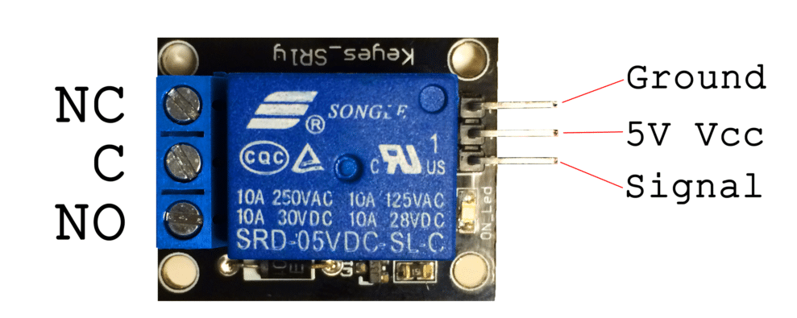
Load Control Through Relay
NORMALLY CLOSED
POWER SUPPLY
This terminal is connected to COM when relay is not powered.
5V VCC and Ground are for external power supply to relay.
NORMALLY OPEN
SIGNAL PORT
This is connected to Load and when relay is powered COM terminal gets connected to this.
This receives signal from smartphone.

Slide 13
THANK YOU

